Slide 1


NAME : B.S.ATHISH
COLLEGE : PANIMALAR INSTITUTE OF TECHNOLOGY
DEGREE : B.E
BRANCH : COMPUTER SCIENCE & ENGINEERING
EMAIL : bsathish.1464.2@gmail.com
NM ID : au211521104018
FINAL PROJECT

Slide 2
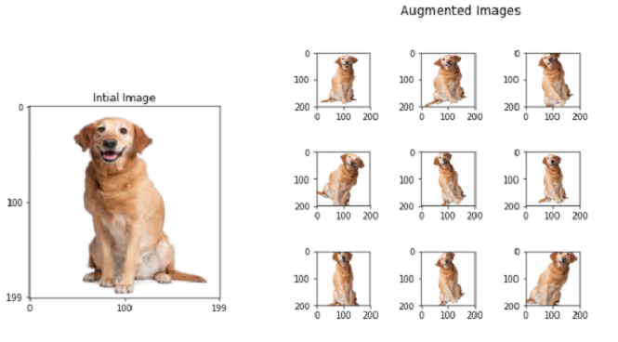
PROJECT TITLE
IMAGE AUGMENTATION USING GAN

Slide 3
AGENDA
PROBLEM STATEMENT
PROJECT OVERVIEW
WHO ARE THE END USERS?
YPUR SOLUTION & ITS VALUE PROPOSITION
THE WOW IN YOUR SOLUTION
MODELLING
RESULT

Slide 4

PROBLEM STATEMENT
By generating realistic images that closely replicate the distribution of the original dataset, Generative Adversarial Networks, or GANs, use the data for image augmentation, thereby improving both model training and generalization. This approach enhances the performance of machine learning models in tasks such as object detection, segmentation, and picture classification by overcoming the limitations of conventional augmentation methods.

Slide 5
PROJECT OVERVIEW
The intention of this project is to enhance images with the help of Generative Adversarial Networks (GANs). Synthetic images that almost differ from the original data but nevertheless strongly resemble it are produced by training a GAN model on a dataset. For tasks like object detection and image classification, the robustness and generalization abilities of machine learning models can be improved by this augmented dataset

Slide 6

WHO ARE THE END USERS?
Graphic Designers and Artists
Photographers
E-commerce Platforms
Medical Imaging Professionals
Architects and Urban Planners
VR & AR Developers

Slide 7

YOUR SOLUTION & ITS VALUE PROPOSITION
By manually extending datasets with image modifications, image augmentation enhances accuracy and robustness of machine learning models without the need for new data acquisition.
By fast production of realistic images, enhanced generalization, and increased visual quality, GAN improves the performance of machine learning models in tasks like image classification, recognition of objects, and segmentation.

Slide 8
WOW IN YOUR SOLUTION
vision innovation called image augmentation makes realistic adjustments to previous images. A discriminator and a generator cooperate in a GAN to produce a range of high-quality images. New datasets are included through this adversarial training process, which further strengthens machine learning models-especially in fields like object detection, image classification, and semantic segmentation.

Slide 9
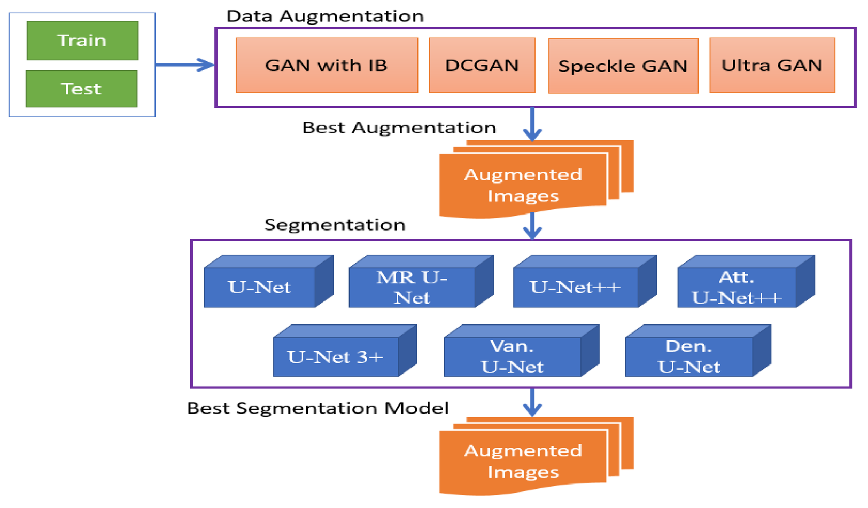
MODELLING

Slide 10
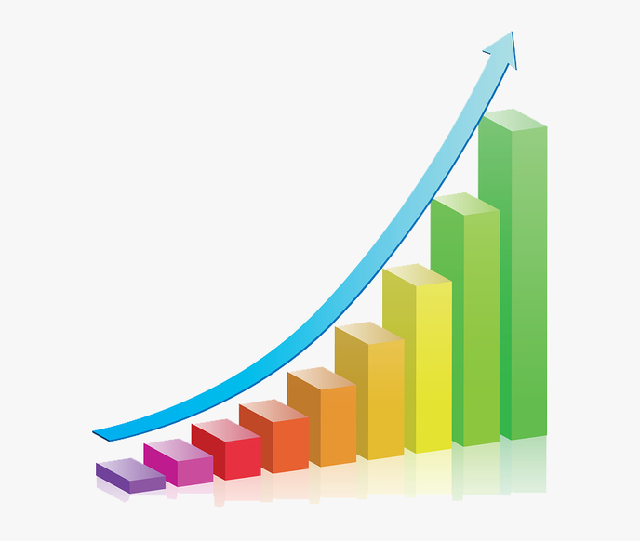
RESULT
Generative Adversarial Networks (GANs) are the method for enriching training datasets with realistic synthetic images. This approach increases the quantity and quality of data which can be used to train machine learning models, that improves the models' generalization and performance on a variety of tasks, namely object recognition, picture segmentation, and classification.

